Slide 1

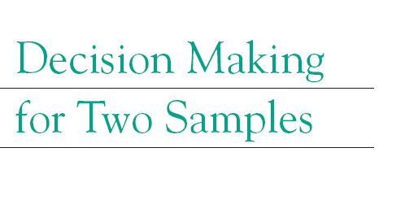

Slide 2
Two independent populations
What is the difference between average height of men vs women.
How much improvement in electrical conductivity of
transparent conducting coating is achieved by the new methods.
Increase in grain size of rice grown under two different controlled
environmental conditions.
Increase in certain type of protein synthesized by bacterial
cells with and without a drug.
Population-I
Population-II

Slide 3



Two independent populations
$$μ_{2}=μ_{20}?$$
$$μ_{1}=μ_{10}?$$
$$μ_{1}−μ_{2}=∆_{0}?$$

Slide 4
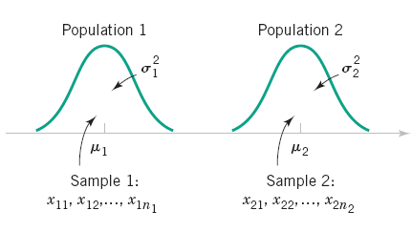
Two independent populations
Consider both populations are normal
Variance of both populations known.

Slide 5
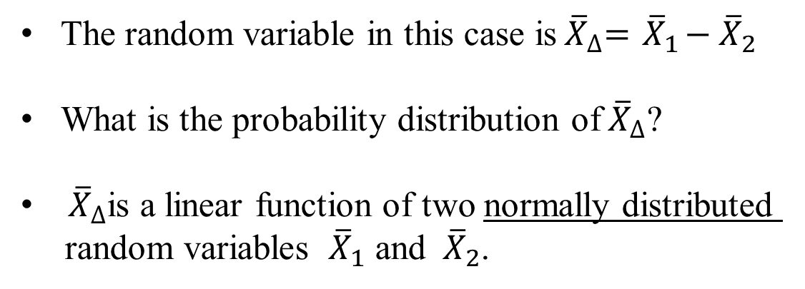
Two independent populations
The random variable in this case is${ \overline{X}}_{∆}={ \overline{X}}_{1}−{ \overline{X}}_{2}$
What is the probability distribution of${ \overline{X}}_{∆}$?
${ \overline{X}}_{∆}$is a linear function of two normally distributed
random variables ${ \overline{X}}_{1}$ and ${ \overline{X}}_{2}$.

Slide 6

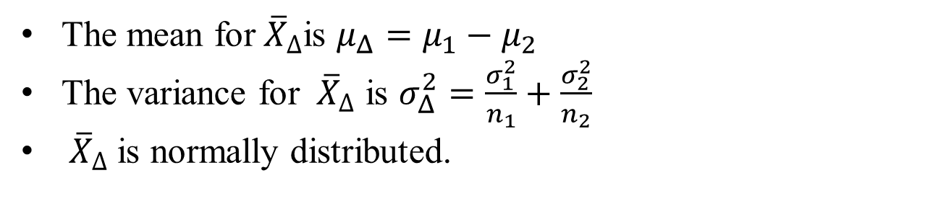
Probability distribution of ${ \overline{X}}_{∆}$
The mean for${ \overline{X}}_{∆}$is $μ_{Δ}=μ_{1}−μ_{2}$
The variance for ${ \overline{X}}_{∆}$ is $σ_{Δ}^{2}=\frac{σ_{1}^{2}}{n_{1}}+\frac{σ_{2}^{2}}{n_{2}}$
${ \overline{X}}_{∆}$ is normally distributed.

Slide 7
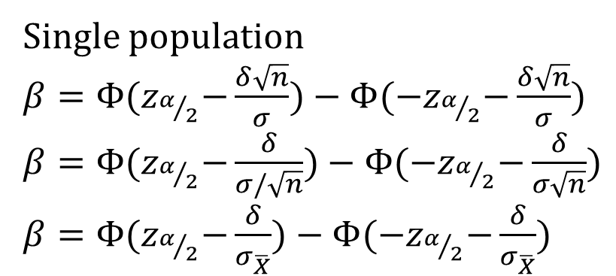
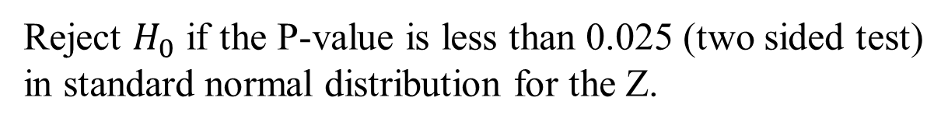
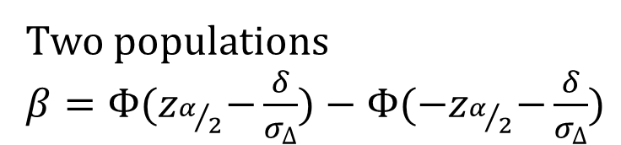
Type I and Type II errors
Reject $H_{0}$ if the P-value is less than 0.025 (two sided test)
in standard normal distribution for the Z.
Single population
$β=Φ{(z}_{α/2}−\frac{δ\sqrt{n}}{σ})−Φ{(−z}_{α/2}−\frac{δ\sqrt{n}}{σ})$
$β=Φ{(z}_{α/2}−\frac{δ}{σ/\sqrt{n}})−Φ{(−z}_{α/2}−\frac{δ}{σ\sqrt{n}})$
$β=Φ{(z}_{α/2}−\frac{δ}{σ_{\overline{X}}})−Φ{(−z}_{α/2}−\frac{δ}{σ_{\overline{X}}})$
Two populations
$β=Φ{(z}_{α/2}−\frac{δ}{σ_{∆}})−Φ{(−z}_{α/2}−\frac{δ}{σ_{∆}})$

Slide 8
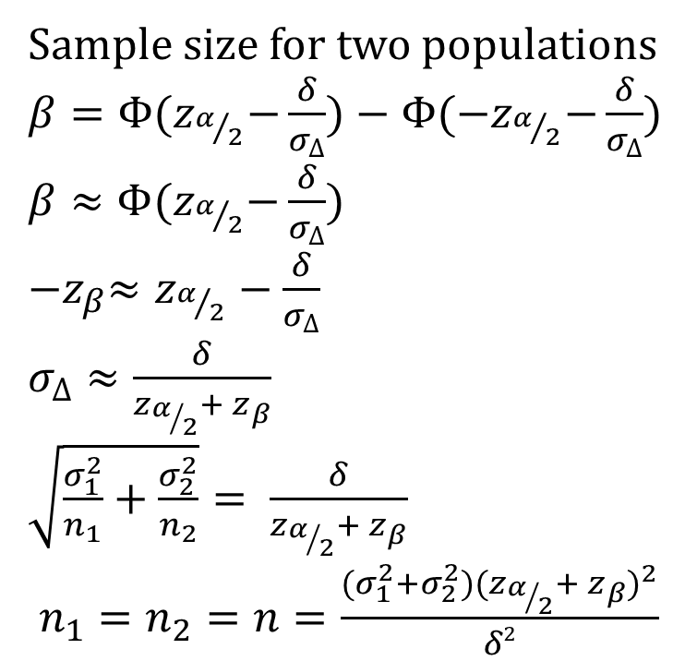
Calculation of sample size
Sample size for two populations
$β=Φ{(z}_{α/2}−\frac{δ}{σ_{∆}})−Φ{(−z}_{α/2}−\frac{δ}{σ_{∆}})$
$β≈Φ{(z}_{α/2}−\frac{δ}{σ_{∆}})$
${−z}_{β}≈z_{α/2}−\frac{δ}{σ_{∆}}$
$σ_{∆}≈\frac{δ}{z_{α/2}+ z_{β}}$
$\sqrt{\frac{σ_{1}^{2}}{n_{1}}+\frac{σ_{2}^{2}}{n_{2}}}= \frac{δ}{z_{α/2}+ z_{β}}$
$n_{1}=n_{2}=n=\frac{(σ_{1}^{2}+σ_{2}^{2}){(z_{α/2}+ z_{β})}^{2}}{δ2}$

Slide 9
Computation of confidence interval

Slide 10

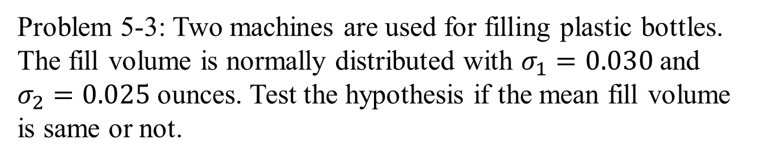

Two population test: Example
Problem 5-3: Two machines are used for filling plastic bottles.
The fill volume is normally distributed with $σ_{1}=0.030$ and
$σ_{2}=0.025$ ounces. Test the hypothesis if the mean fill volume
is same or not.
$${\overline{X}}_{1}=16.015$$
$${\overline{X}}_{2}=16.005$$

Slide 11
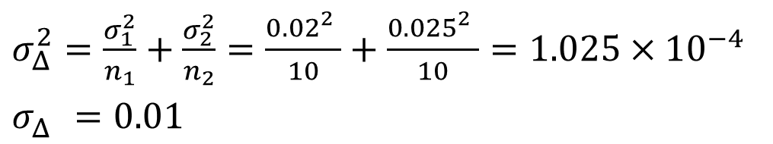
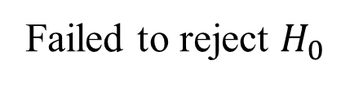

Two population test: Example
$${ \overline{X}}_{∆}={ \overline{X}}_{1}−{ \overline{X}}_{2}=0.01$$
$σ_{Δ}^{2}=\frac{σ_{1}^{2}}{n_{1}}+\frac{σ_{2}^{2}}{n_{2}}=\frac{{0.02}_{}^{2}}{10}+\frac{{0.025}_{}^{2}}{10}=1.025×{10}^{−4}$
$σ_{Δ}^{}=0.01$
Two sided test. P-value $=2\left(1−Φ\left(Z\right)\right)=2\left(1−Φ\left(1\right)\right)=0.317$
Failed to reject $H_{0}$

Slide 12
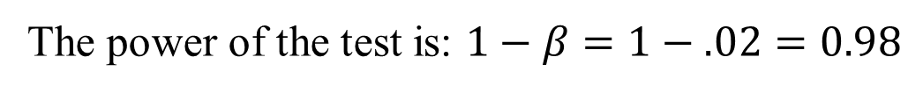
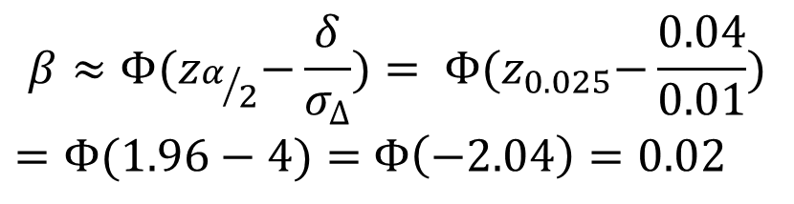
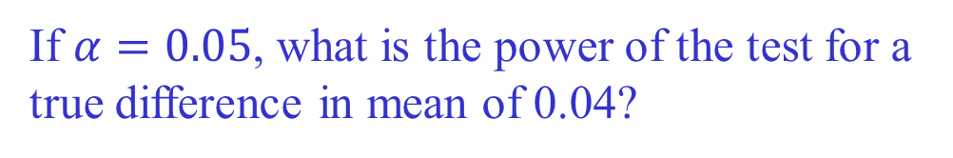
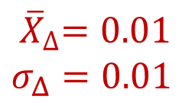
Two population test: Example
${ \overline{X}}_{∆}=0.01$
$σ_{Δ}=0.01$
If $α=0.05$, what is the power of the test for a
true difference in mean of 0.04?
$$β≈Φ{(z}_{α/2}−\frac{δ}{σ_{∆}})= Φ{(z}_{0.025}−\frac{0.04}{0.01})$$
$=Φ(1.96−4)=$ $Φ\left(−2.04\right)=0.02$
The power of the test is: $1−β=1−.02=0.98$
Find 95% CI on the difference in mean.

Slide 13
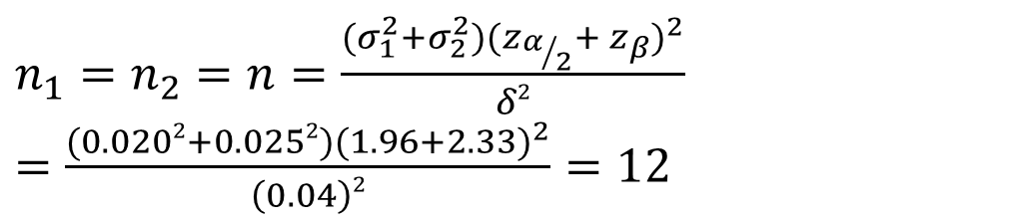
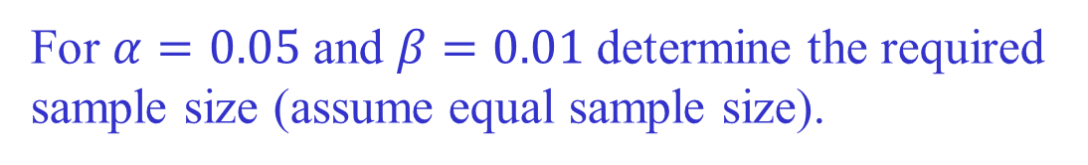
Two population test: Example
${ \overline{X}}_{∆}=0.01$
$σ_{Δ}=0.01$
For $α=0.05$ and $β=0.01$determine the required
sample size (assume equal sample size).
$n_{1}=n_{2}=n=\frac{(σ_{1}^{2}+σ_{2}^{2}){(z_{α/2}+ z_{β})}^{2}}{δ2}$
$=\frac{(0.0202+0.0252){(1.96+2.33)}^{2}}{\left(0.04\right)2}=12$

Slide 14
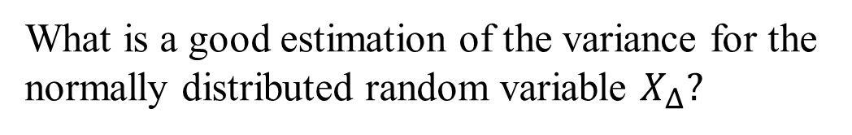
Variance unknown
Variance of both population unknown.
What is a good estimation of the variance for the
normally distributed random variable $X_{Δ}?$

Slide 15
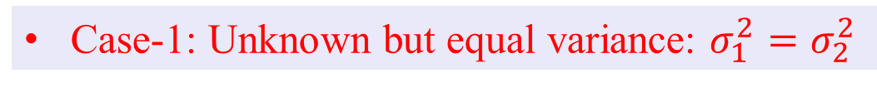
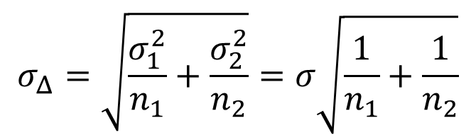
Variance unknown
Case-1: Unknown but equal variance: $σ_{1}^{2}=σ_{2}^{2}$
$$σ_{Δ}=\sqrt{\frac{σ_{1}^{2}}{n_{1}}+\frac{σ_{2}^{2}}{n_{2}}}=σ\sqrt{\frac{1}{n_{1}}+\frac{1}{n_{2}}}$$

Slide 16
Variance unknown
Case-1: Unknown but equal variance: $σ_{1}^{2}=σ_{2}^{2}$
$$σ_{Δ}=\sqrt{\frac{σ_{1}^{2}}{n_{1}}+\frac{σ_{2}^{2}}{n_{2}}}=σ\sqrt{\frac{1}{n_{1}}+\frac{1}{n_{2}}}$$

Slide 17
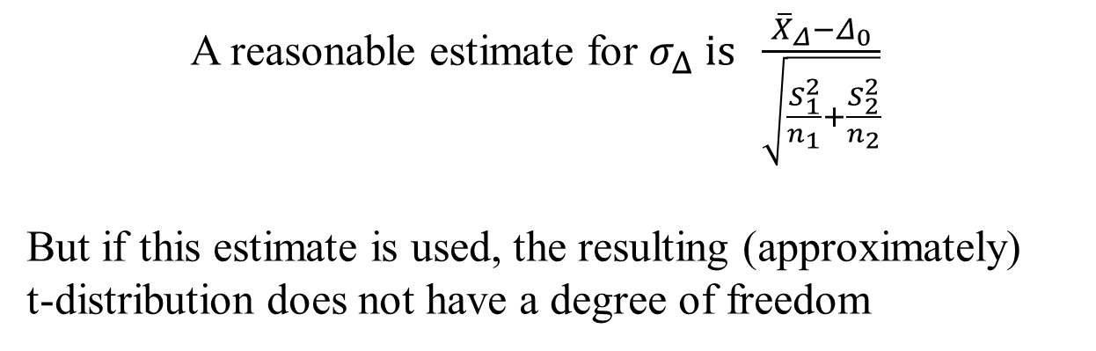
Variance unknown
Case-2: Unknown and unequal variance: $σ_{1}^{2}≠σ_{2}^{2}$
A reasonable estimate for $σ_{Δ} is \frac{{\overline{X}}_{Δ}−Δ_{0}}{\sqrt{\frac{S_{1}^{2}}{n_{1}}+\frac{S_{2}^{2}}{n_{2}}}}$
But if this estimate is used, the resulting (approximately)
t-distribution does not have a degree of freedom

Slide 18
Two population t-Test: Example
5-23: In semiconductor industries, etching of silicon wafer is
a common process. The wafer is washed with a solution and
the rate at which the dissolution from the surface occurs is an
important property. Two solutions are being tested for their
etching rate:
Do the data support the claim that the mean etch rate is the same
for both solutions?

Slide 19




Two population t-Test: Example
Two sided test
$${\overline{X}}_{1}=9.97$$
$${\overline{X}}_{2}=10.4$$
$$S_{1}=0.4218$$
$$S_{2}=0.2309$$
Variance is not known. Hence, t-Test is required.
Variance same for the two population or different?
Use probability plot.

Slide 20
Two population t-Test: Example

Slide 21
Variance unknown
Case-2: Unknown and unequal variance: $σ_{1}^{2}≠σ_{2}^{2}$

Slide 22
Variance unknown
Reject $H_{0}$ (There is significant difference in mean)

Slide 23
Type II Error and Choice of Sample Size
The softening temperature (ºF) of two different plastics are as follows:
Are the two means different?

Slide 24
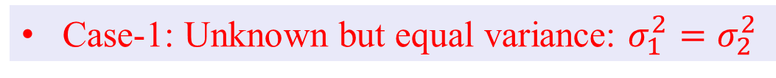
Type II Error and Choice of Sample Size
Case-1: Unknown but equal variance: $σ_{1}^{2}=σ_{2}^{2}$

Slide 25
Two population t-Test: Example
Two sided test

Slide 26
Type II Error and Choice of Sample Size
Suppose the mean softening temperature of type-2 exceeds that of
type-1 by 5 ºF. It is important to detect this difference with 90%
probability with significance level of 0.05.
Determine if the sample size used is adequate or not.

Slide 27
Type II Error and Choice of Sample Size
The same curves can be used with two modification:
1
2
The $n$ obtained from the curve is actually $2n−1$

Slide 28
Type II Error and Choice of Sample Size
Suppose the mean softening temperature of type-2 exceeds that of
type-1 by 5 ºF. It is important to detect this difference with 90%
probability with significance level of 0.05.
Determine if the sample size used is adequate or not.
Sample size is not adequate

Slide 29
Paired t-Test
Hypothesis: Blood pressure measured on left arm is different
from that measured on right arm.
Take 100 healthy individuals
Measure BP(L) and BP(R)
Conduct two population t-test
BP(L): Population-1
BP(R): Population-2

Slide 30
Paired t-Test

Slide 31
Paired t-Test
Hypothesis: Blood pressure measured on left arm is different
from that measured on right arm.
BP(L): Population-1
BP(R): Population-2
Violation of the ‘independent random variable’ assumption!
Loss of vital information!
BP(L)-BP(R): Population

Slide 32
Paired t-Test

Slide 33
Paired t-Test
The two random variables used in the two populations
are not independent random variables. They have correlation.
If the BP is high on the left arm, it will tend to be high
on the right arm as well.
Surface water heavy metal content vs ground water heavy
metal content
Height of 10 year old boys and girls from
- randomly chosen students in a school.
- visiting individual houses and recording the height of
all children in that house

Slide 34
Paired t-Test
Problem 5-42: Blood cholesterol level of 15 adult males of
comparable height, body weight and regular physical activity
level were measured before and after a three week long
strenuous aerobic exercise.
Does the data support the claim that exercise has significant
impact on blood cholesterol level?

Slide 35
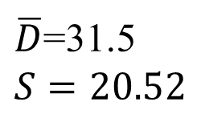
Paired t-Test
Subject | Before | After | D
1 | 265 | 229 | 39
2 | 240 | 231 | 9
3 | 258 | 227 | 31
4 | 295 | 240 | 55
5 | 251 | 238 | 13
6 | 245 | 241 | 4
7 | 287 | 234 | 53
8 | 314 | 256 | 58
9 | 260 | 247 | 13
10 | 279 | 239 | 40
$\overline{D}$=31.5
$S=20.52$

Slide 36
Two sample t-Test
 | Pop-I | Pop-II
Subject | Before | After
1 | 265 | 229
2 | 240 | 231
3 | 258 | 227
4 | 295 | 240
5 | 251 | 238
6 | 245 | 241
7 | 287 | 234
8 | 314 | 256
9 | 260 | 247
10 | 279 | 239

Slide 37
Paired vs. unpaired t-Test
Paired
Two Pop

Slide 38
Paired t-Test vs unpaired t-Test
Paired t-Test should be used when there is correlation between
random variables.
Should we use paired t-Test even if the correlation is weak?
Two sample t-Test
Paired t-Test
1. We are loosing n degrees of freedom while using paired t-Test.

Slide 39
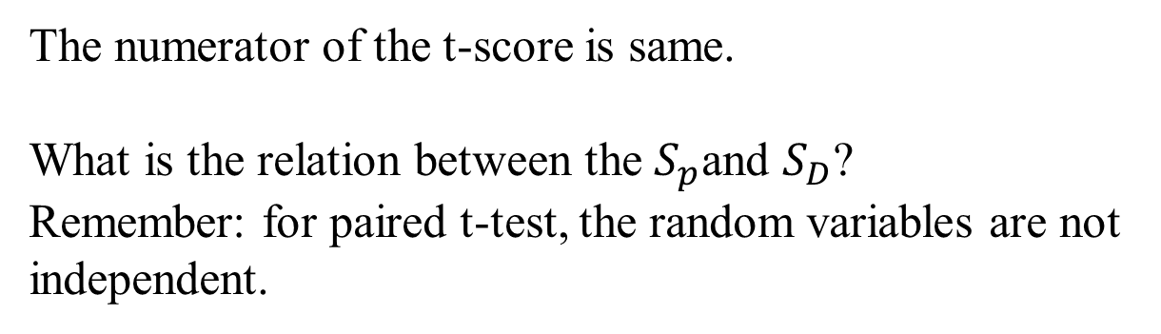
Paired t-Test vs unpaired t-Test
The numerator of the t-score is same.
What is the relation between the $S_{p}$and $S_{D}$?
Remember: for paired t-test, the random variables are not
independent.

Slide 40
Paired t-Test vs unpaired t-Test

Slide 41
Paired t-Test vs unpaired t-Test

Slide 42
Paired t-Test vs unpaired t-Test
If no correlation exists and we presume correlation, we get identical t-score but loose degrees of freedom.

Slide 43
Paired vs. unpaired t-Test
2.3

Slide 44
Calculation of covariance
Problem 3-171
Y X | 0 | 6 | 12
0 | 0.50 | 0.05 | 0.10 | 0.65 | 0
6 | 0.05 | 0.10 | 0.05 | 0.20 | 1.2
12 | 0.10 | 0.05 | 0.00 | 0.15 | 1.8
 | 0.65 | 0.20 | 0.15 |  | 3.0
 | 0 | 1.2 | 1.8 | 3.0
Y X | 0 | 6 | 12
0 | 0 | 0 | 0
6 | 0 | 3.6 | 3.6
12 | 0 | 3.6 | 0

Slide 45
Calculation of covariance
Y X | 0 | 6 | 12
0 | 0.50 | 0.05 | 0.10 | 0.65 | 0
6 | 0.05 | 0.10 | 0.05 | 0.20 | 1.2
12 | 0.10 | 0.05 | 0.00 | 0.15 | 1.8
 | 0.65 | 0.20 | 0.15 |  | 3.0
 | 0 | 1.2 | 1.8 | 3.0

Slide 46
Hypothesis Testing on equality of variances

Slide 47
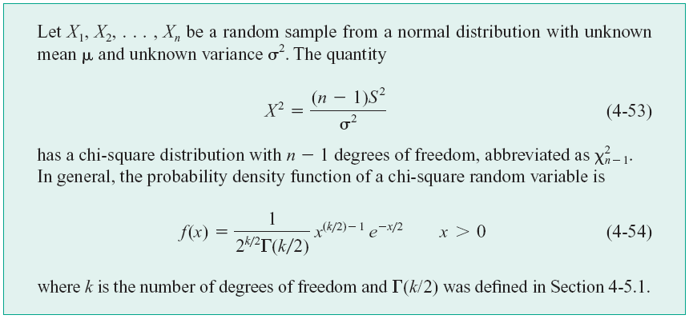
Single population variance

Slide 48
Inference on the Ratio of Variances
of Two Normal Populations
The random variable:
It turns out that is it easier to obtain the probability density
function for :
Which is known as “F distribution function”.

Slide 49
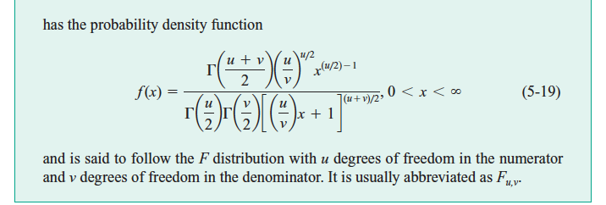
The F Distribution

Slide 50

The $χ^{2}$vs F Distribution

Slide 51
The F Distribution

Slide 52
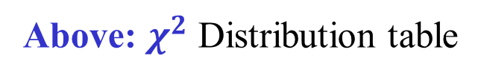
The $χ^{2}$vs F Distribution
Above: $χ^{2}$ Distribution table
The F distribution Tables supply only the values of x for probabilities 0.25, 0.1, 0.05, 0.025 and 0.010.

Slide 53
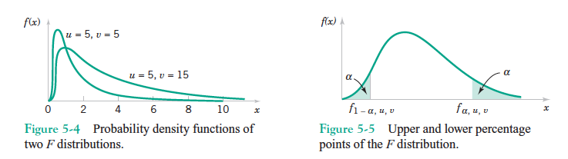

The F Distribution
The F distribution Tables supply only the values of x for probabilities 0.25, 0.1, 0.05, 0.025 and 0.010 and the lower critical values are found by using:

Slide 54
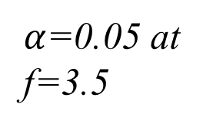
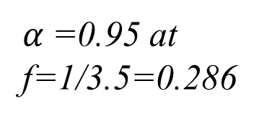
The F Distribution
Percentage points (1-cumulative value)
$α$=0.05 at
f=3.5
$α$=0.95 at
f=1/3.5=0.286

Slide 55
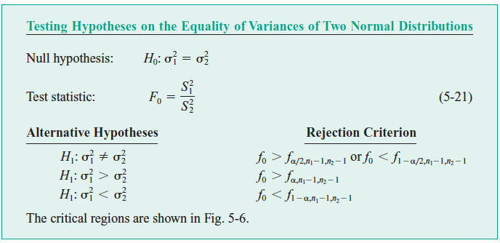
Inference on the Ratio of Variances
of Two Normal Populations

Slide 56
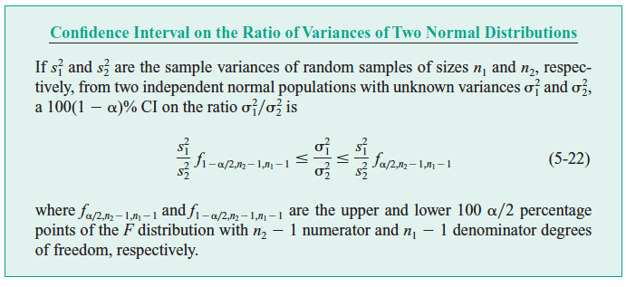
Confidence Interval on the Ratio of Two Variances

Slide 57
Inference on the Ratio of Variances: Example
5-55: In semiconductor industries, etching of silicon wafer is
a common process. The wafer is washed with a solution and
the rate at which the dissolution from the surface occurs is an
important property. Two solutions are being tested for their
etching rate:
Do the data support the claim that the variance in etch rate is same?

Slide 58
Inference on the Ratio of Variances: Example
DOF=9 for both

Slide 59
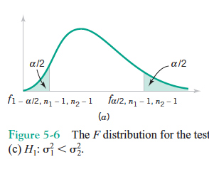


Inference on the Ratio of Variances: Example
$$S_{1}=0.4218$$
$$S_{2}=0.2309$$
Since F value is between these two limits, failed to reject
the null hypothesis.

Slide 60
Confidence interval on the Ratio of Variances
For mean:
For variance:

Slide 61
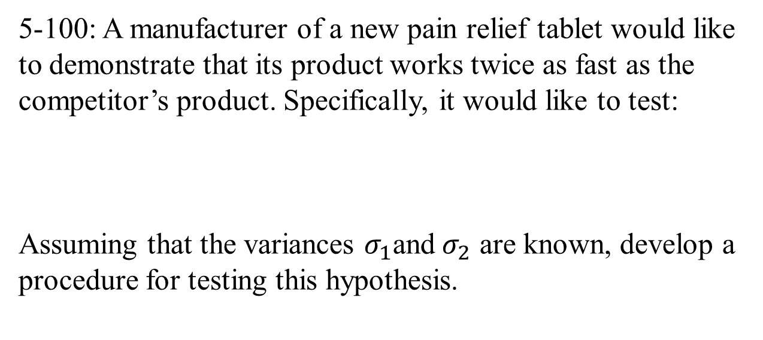
Additional Problems:
5-100: A manufacturer of a new pain relief tablet would like
to demonstrate that its product works twice as fast as the
competitor’s product. Specifically, it would like to test:
Assuming that the variances $σ_{1}$and${ σ}_{2}$ are known, develop a
procedure for testing this hypothesis.

Slide 63
Additional Problems:
5-92: A liquid dietary product implies in its advertisement that
use of the product for one month results in an average weight
loss of at least 3 pounds. Eight subjects use the product for
one month and the resulting weight loss data is reported here:

Slide 64
Additional Problems:
Do the data support the claim that the probability of type-I
error is 0.05?
Can they claim that the probability of type-I error is 0.01?
In an effort to improve the sale, they are considering changing
the claim to “at least 5 pounds”. Is this claim reasonable?

Slide 65
Experiments and conclusions:
Conclusion: Mean life of thermocouple > 540 hours

Slide 66
Experiments and conclusions:

Slide 67
Experiments and conclusions:

Slide 68
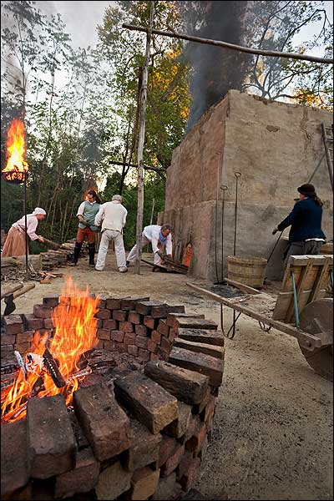
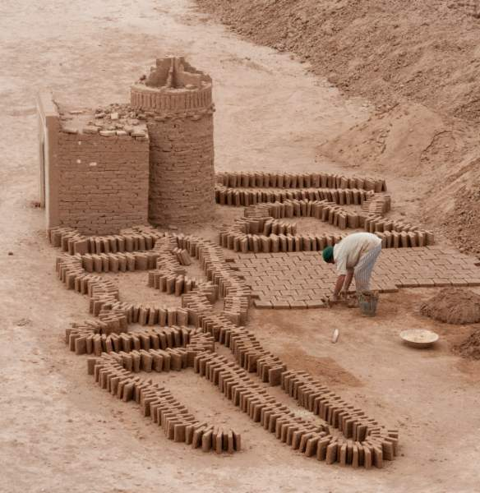
Experiments and conclusions:

Slide 69
Experiments and conclusions:
Factor
Levels
Treatments
Replicates

Slide 70
Experiments and conclusions:

Slide 71
Test between all possible pairs?
Conclusion: Temperature has no effect on density
Conclusion: Temperature has effect on density

Slide 72
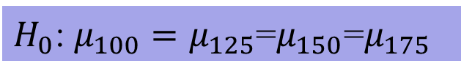
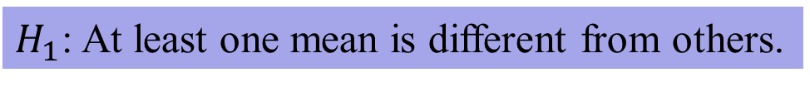
Setting up the hypothesis
$H_{0}$: $μ_{100}=μ_{125}$=$μ_{150}$=$μ_{175}$
$H_{1}$: At least one mean is different from others.

Slide 73
Change in observed value due to
factor and due to random-error
Factor

Slide 74
Change in observed value due to a “factor” and due to random-error
Factor

Slide 75




Change in observed value due to a “factor” and due to random-error
$$i=1$$
$$i=2$$
$$i=3$$
$$i=4$$

Slide 76
Change in observed value due to a “factor” and due to random-error
$$i=1$$
$$i=2$$
$$i=3$$
$$i=4$$

Slide 77
Errors…

Slide 78
Errors…
a treatments
n observations

Slide 79
Errors…
Variance-TR
Variance-ER

Slide 80
Errors…
If the variance among treatments is same as variance
due to error, no difference in mean due to treatment exists.
We actually test the hypothesis on variance to test the equality
of multiple mean values. This is ANAlysis Of VAriance.

Slide 81
Structure of the test

Slide 82
Efficient computation of sums

Slide 83
Example

Slide 84
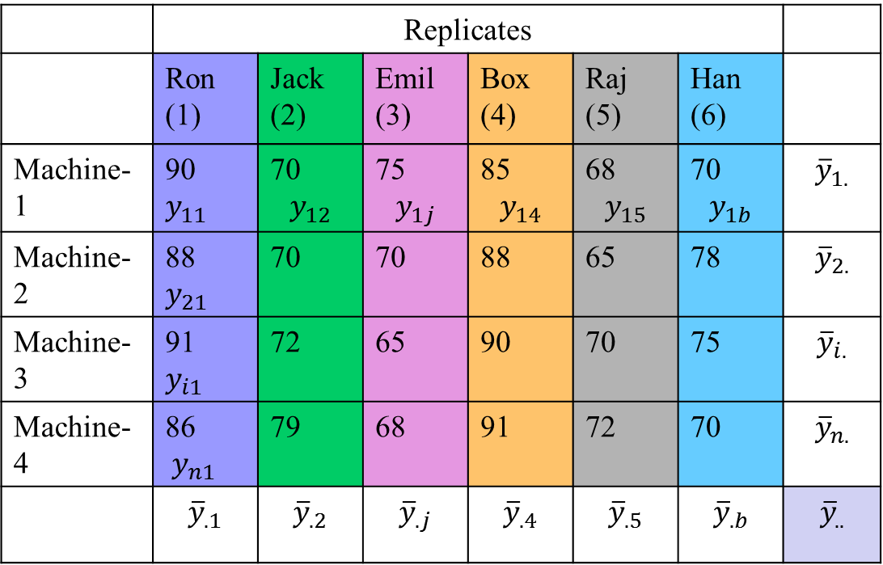
Replicates have “nuisance factor”!
b “blocks” (j=1,b)
 | Replicates
 | Ron (1) | Jack (2) | Emil (3) | Box (4) | Raj (5) | Han (6)
Machine-1 | 90 $y_{11}$ | 70 $$y_{12}$$ | 75 $$y_{1j}$$ | 85 $$y_{14}$$ | 68 $$y_{15}$$ | 70 $$y_{1b}$$ | $${\overline{y}}_{1.}$$
Machine-2 | 88 $y_{21}$ | 70 | 70 | 88 | 65 | 78 | $${\overline{y}}_{2.}$$
Machine-3 | 91 $y_{i1}$ | 72 | 65 | 90 | 70 | 75 | $${\overline{y}}_{i.}$$
Machine-4 | 86 $y_{n1}$ | 79 | 68 | 91 | 72 | 70 | $${\overline{y}}_{n.}$$
 | $${\overline{y}}_{.1}$$ | $${\overline{y}}_{.2}$$ | $${\overline{y}}_{.j}$$ | $${\overline{y}}_{.4}$$ | $${\overline{y}}_{.5}$$ | $${\overline{y}}_{.b}$$ | $${\overline{y}}_{..}$$
a treatments (i=1,a)

Slide 85
Errors…
Partitioning of DF: $ab−1=\left(a−1\right)+\left(b−1\right)+(a−1)(b−1)$

Slide 86
Computation formulas

Slide 87
Example

